Slide 1
Boutique Product Analysis Presentation

Slide 2
Business Analysis Plan
Problem
Methodology
Group
Project
Results
Discussion & Proposed Solution
References & Appendices
Present Team Members

Slide 3
Problem
For the past three months, the store has had some problems with tomato paste orders. In analyzing the operation of the store, they have realized that they are buying too many cans. Since then, they have been asking themselves this question: should the store continue to sell tomato paste or not? Mr. Michel wonders if there is a way to minimize his losses.
Faced with this question, the company's problem is defined as follows: "How can the company continue to sell tomato paste without making a deficit? It is to answer this question that the son of the owner of the store contacted our firm "MFD Consulting Group".

Slide 4
Methodology
First, we have collected the necessary information from the database of the company Boutique for the analysis. For example, purchases, sales, unit prices, stocks, dates and others, will allow to calculate immediately the gross profit margins for each product and for each period. This will allow us to make a quantitative approach to the problem.
Then, we used the Microsoft Excel data processing software to make the calculations on the data and the visualization. The statistical analysis of this data will allow us to see where the company is at, to set up strategies, etc.

Slide 5
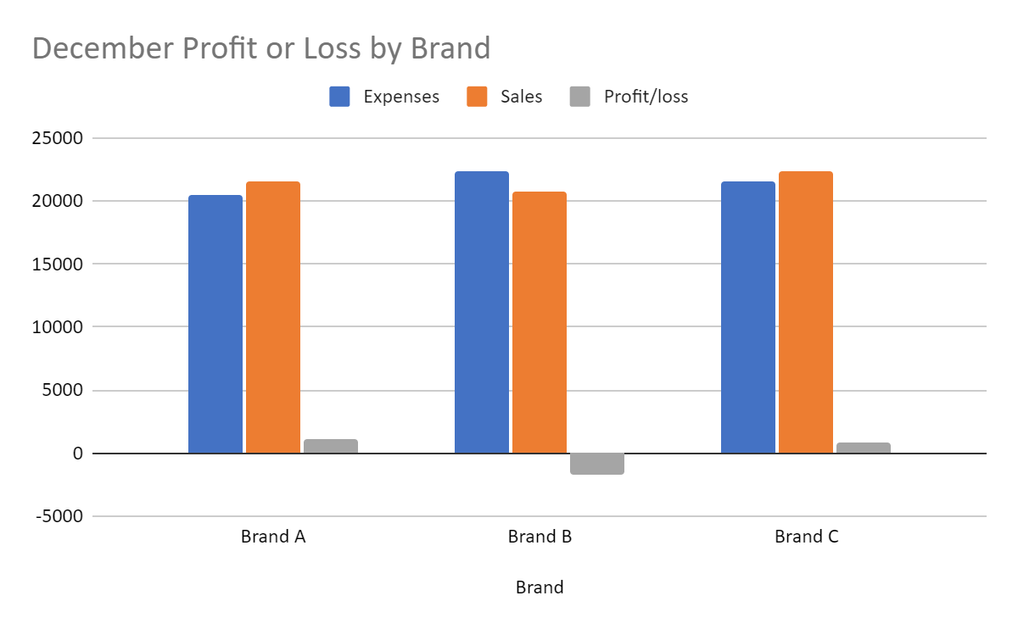
Results:
At the beginning of the fiscal year, in December, the Boutique Company did not show any loss for the brands A and C. On the contrary, the sales volumes of these two brands are higher than their costs. But, unfortunately, for the product B, a loss has been registered.
These results can be explained by the fact that at the beginning of the year, there are no expired products and each sale is a direct gain for the company.

Slide 6
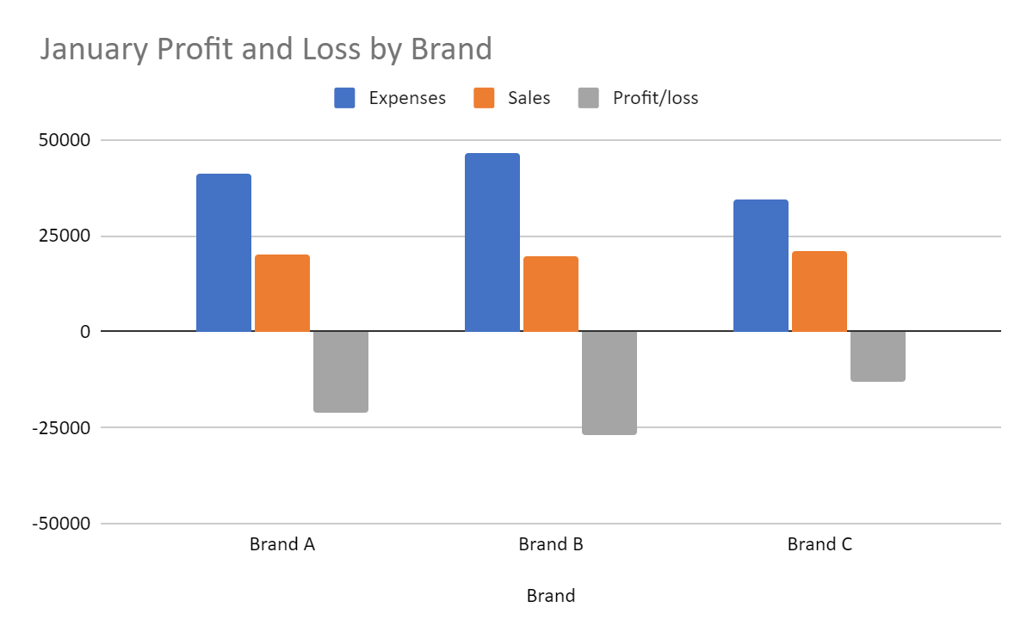
For the month of January, the Boutique Company has made a loss for all brands: A, B and C. B.
Brand B is still the most unfavorable in terms of yield.
A good explanation would be that at the beginning of January there was a large quantity of lost products. These products have a cost, so they will negatively affect its profit margin.

Slide 7
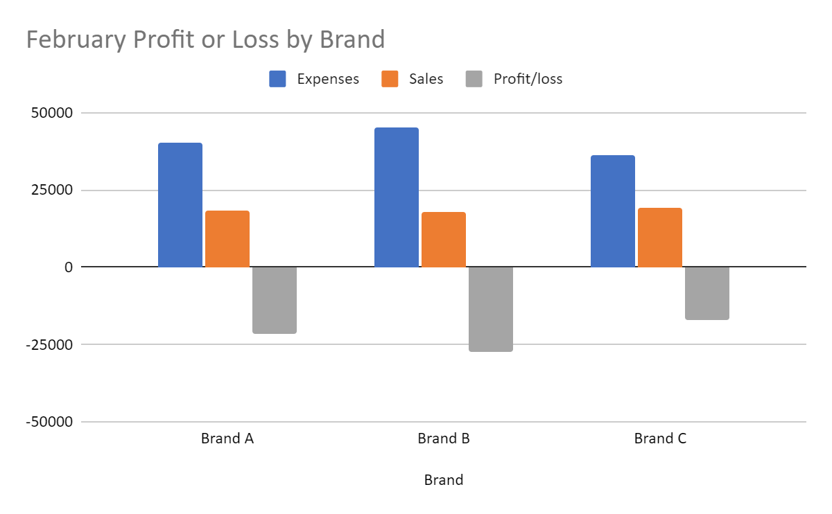
In February, we notice that the situation has not changed, if not worsened.
In spite of the accounting hypothesis: first in, first out. The losses are accumulating, because the brands have a shelf life of one month and in spite of the losses of January, the same amount of products has been ordered.

Slide 8
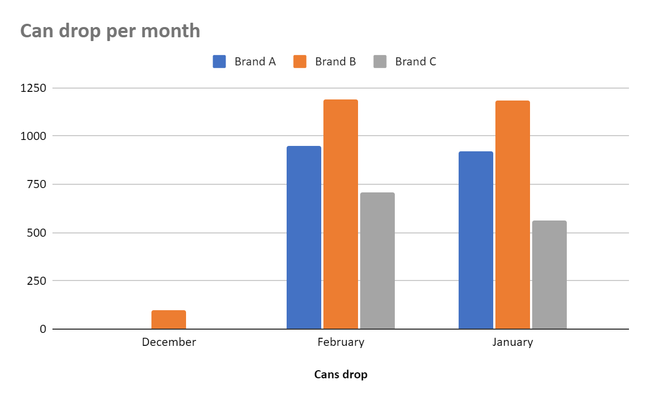
Here we have a graph of the quantity of expired products per month and per brand.
This graph joins our previous analysis on another angle, that of costs.
Directly, the brand B costs the most to the Company. We can say that it is the brand of product least preferred by the customers.

Slide 9
SWOT Analysis
POSITIVE
NEGATIVE
STRENGTH
WEAKNESS
- Record of purchases and sales (Dataset)
- Selling multiple brands of tomato paste (A, B and C)
- Regular replenishment
- Qualified human resources
- Lack of information
- Missing management tools
- Short deadline
- Not enough information about the company's stakeholders
INTERNAL
OPPORTUNITY
THREAT
Discerning clientele;
- Several suppliers;
- Perishable product in one (1) month;
- Competitive market
EXTERNAL

Slide 10
Discussions and Proposed Solutions
Overall, we can already see that the Enterprise has very little chance of being able to survive or to achieve the expected results, which are the continuity of the exercises and the profit.
The solutions to be proposed are of more than one, because the problem does not come from a single source.

Slide 11
Solution I
This is an Inventory Management problem. Indeed, despite the number of expired products, the number of orders was inflexible. A good inventory management would have detected this problem and ordered less next time.
In particular, for brand B, which is as we have just seen, the least preferred by customers, the orders have to go down. There must be some flexibility in the orders and according to each brand.
Strength of the solution.
Reduction of the waste of cans. Increased profits and at the same time reduced losses.
Weaknesses of the solution.
Lack of information about the market.
Recommendations.
Do a market study to have a quantitative idea of the demand.

Slide 12
Solution II
The problem of excess inventory can be explained by the fact that demand is lower than supply.
The second solution we propose is that the customer decreases the quantity of boxes by decreasing the order quantity. Thus, the demand will be at least equal to the supply.
Strength of the solution.
Increase of the company's turnover. Elimination of waste.
Weaknesses of the solution.
Dissatisfaction of the customers not finding products
Recommendations.
It is necessary that the periods of orders are more flexible to avoid the problem of excessive time of out of stock.

Slide 13
Present Team Member:
Djeninah TIMOTHEE
Fred Junior NOEL
Moise MASSON

Slide 14
Thank You

